Slide 1


WEEKLY WORKSHOP - SEMINAR: "Eco-Construction and Bioclimatic Approach in Architecture" October 18-24, 2019 Volos
GREEK ARCHITECTS UNION www.sadas-pea.gr |  | optarch.ntua.gr

Slide 2
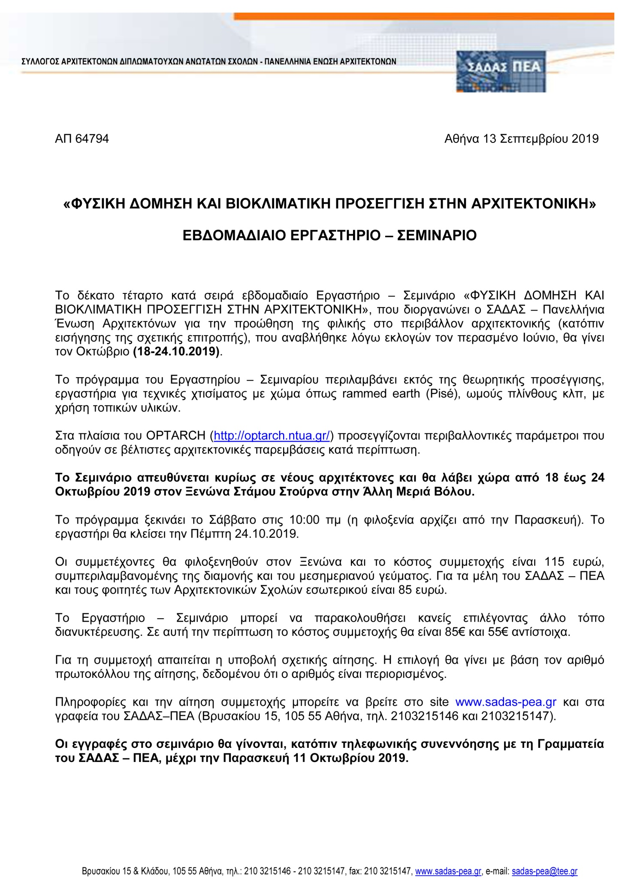
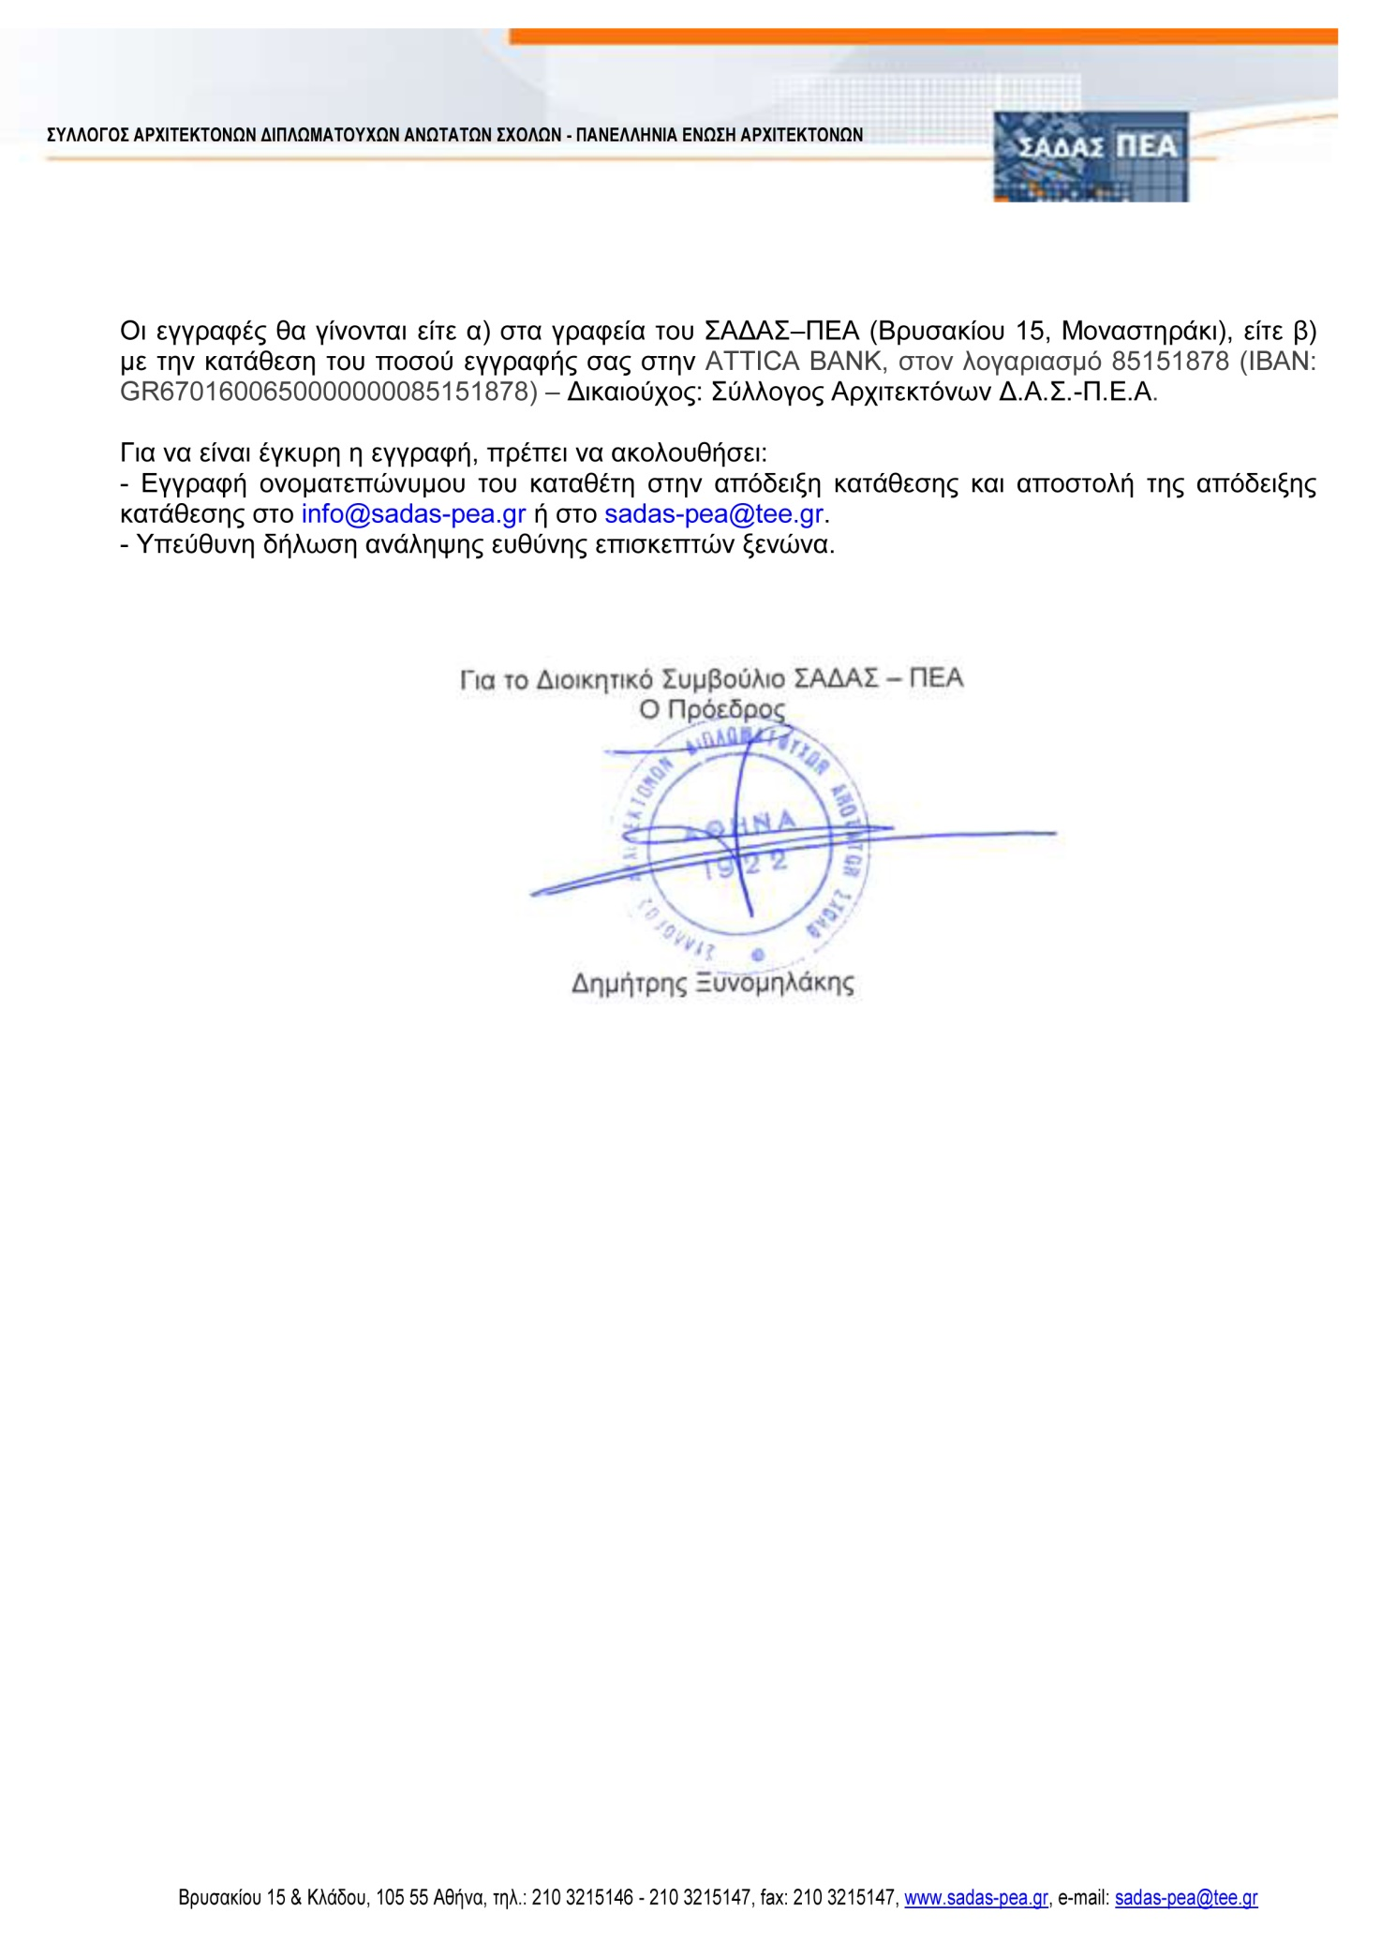
INVITATION

Slide 3
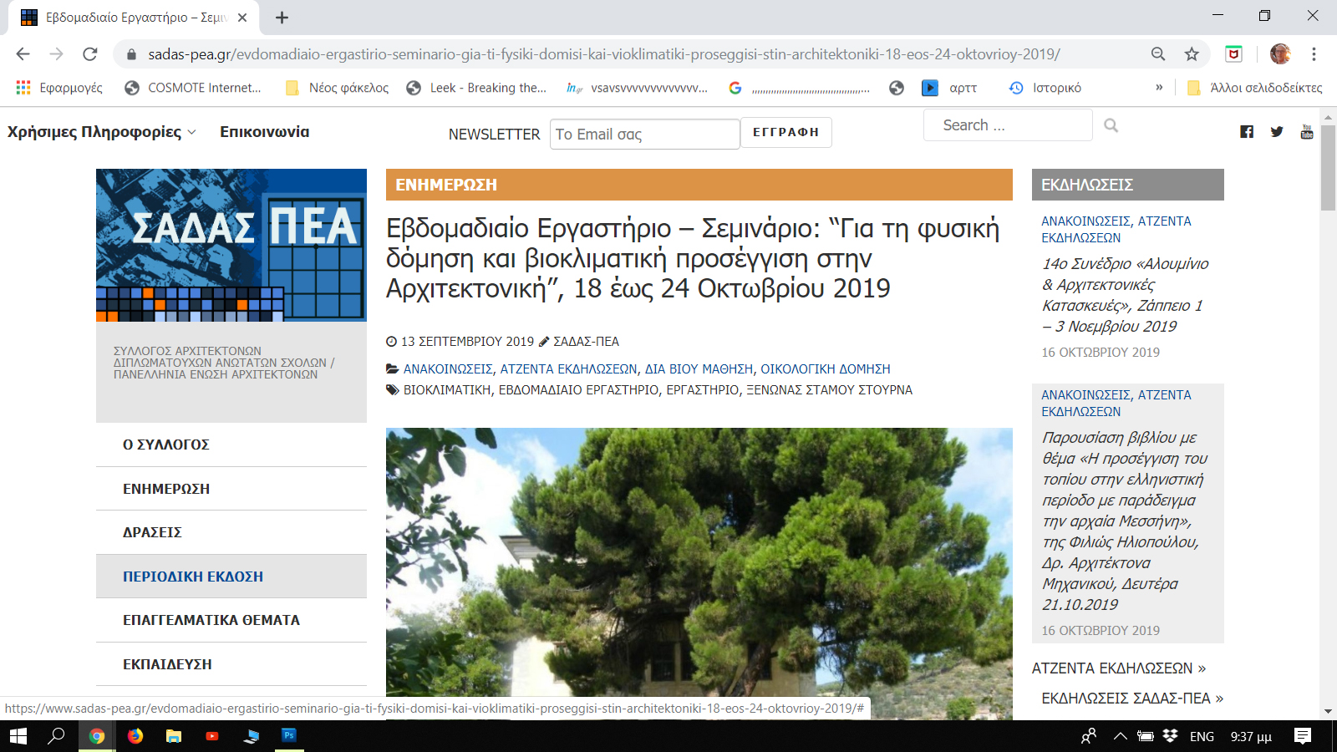
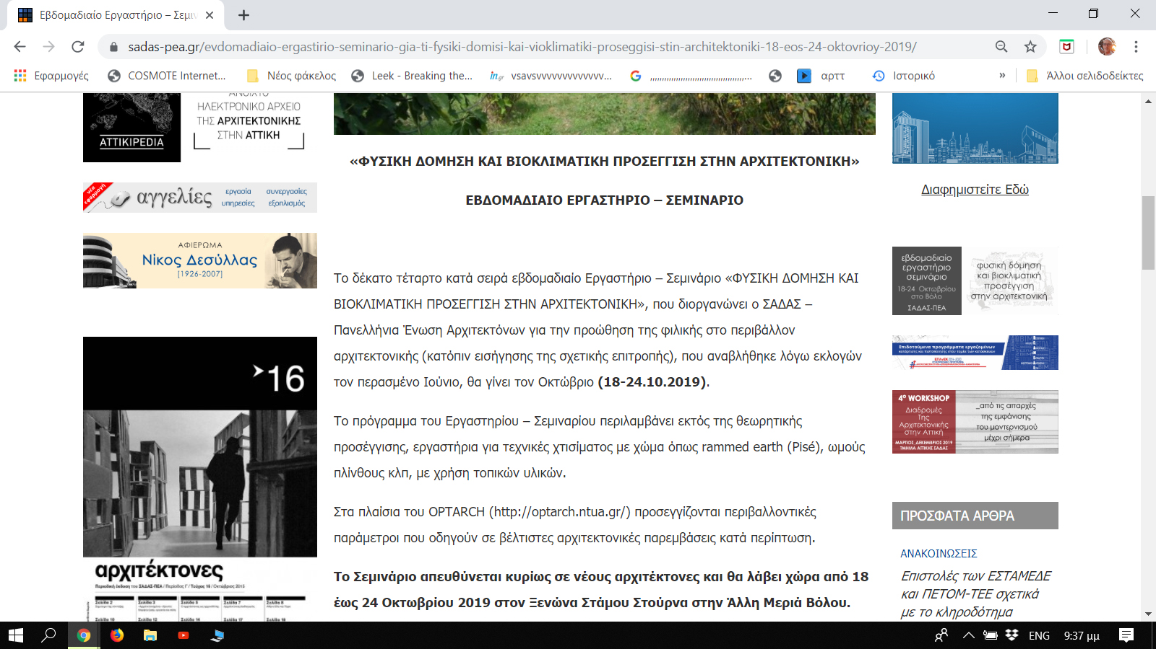
Web INVITATION
www.sadas-pea.gr/evdomadiaio-ergastirio-seminario-gia-ti-fysiki-domisi-kai-vioklimatiki-proseggisi-stin-architektoniki-18-eos-24-oktovrioy-2019

Slide 4
Coordinator: Ourania Economou
Presentations
19.10.2019
Panagiotis Dimitriadis and G.-Fivos Sargentis, Stochastic approach in variables of nature. Related architectural issues
G.-Fivos Sargentis, Optimizing technical decisions. Criteria and variabilities. Case study: selection of building materials with ecological criteria
Evangelia Frangedaki, Optimizing housing needs with earth as building material. Case study: Hakka Tulou
Nikiforos Meimaroglou, Test and methods for the selection of proper earth soil for construction
20.10.2019
Spyros Karagiannis, Contemporary rammed earth “pisé“ construction
21.10.2019
Maria Pantas, Approaches to resilience and adaptation through community-driven construction projects: Building with earth in rural Ghana and rural Cyprus
23.10.2019
Vana Georgala, Earth buildings: issues of construction and thermal behavior.
24.10.2019
Vassilis Sgoutas (UIA Honorary President), Nikos Fintikakis (UIA Vice-President), UIA role and Ecological Architecture
Workshop
19.10.2019
Preparing the material, methods and tests for rammed earth construction
Construction of the mold for rammed earth “pisé“
20.10.2019
“Pisé“ wall was constructed, in situ, with local materials by the participants under the direction of Architect Spyros Karagiannis
21.10.2019
Preparing the material, methods and tests for adobes
22.10.2019
Adobes was constructed, in situ, with local materials by the participants under the direction of Architect Maria Pantas
23-24.10.2019
Visiting examples of bioclimatic design and earth-construction in traditional village of Pilio and modern residences of Volos
Panagiotis Dimitriadis , Civil Engineer, Dr .Engineer ∙ Ourania Economou, Architect ∙ Vana Georgala, Architect , Ph.D. candidate ∙ Spyros Karagiannis, BA, BArch , MSc Architectural Engineering: Environmental Design∙ Nikiforos Meimaroglou, Civil Engineer, Ph.D. candidate ∙Dr. Maria Panta, PhD Architect, RIBA Pt II Canterbury School of Architecture University for the Creative Arts (UCA) ∙ G.-Fivos Sargentis, Civil Engineer, Dr .Engineer ∙ Vassilis Sgoutas, Architect (UIA Honorary President) ∙ Nikos Fintikakis , Architect (UIA Vice-President)∙ Evangelia Frangedaki, Architect, Specialized and Laboratory Teaching Staff, MSc Architecture, ΜΑ Digital Arts

Slide 5
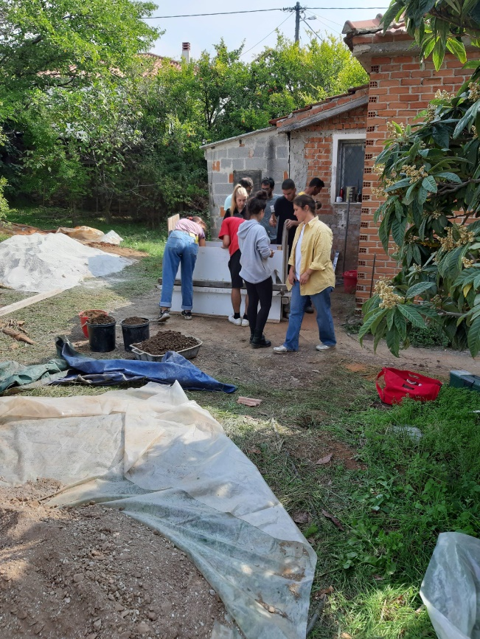
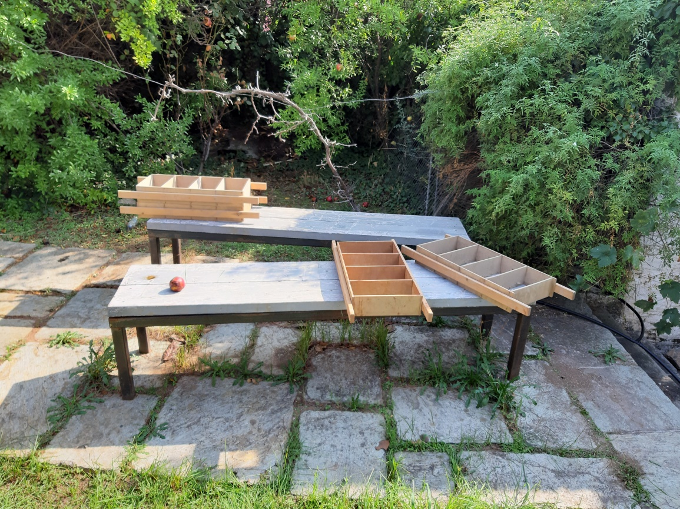
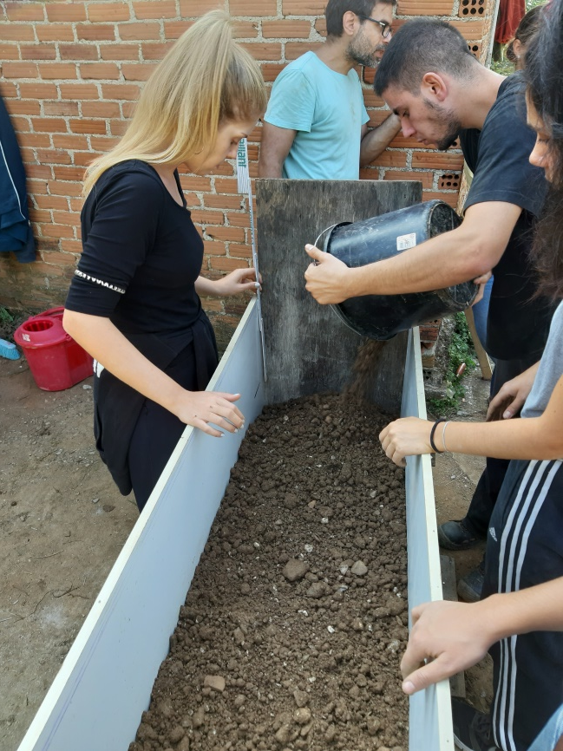
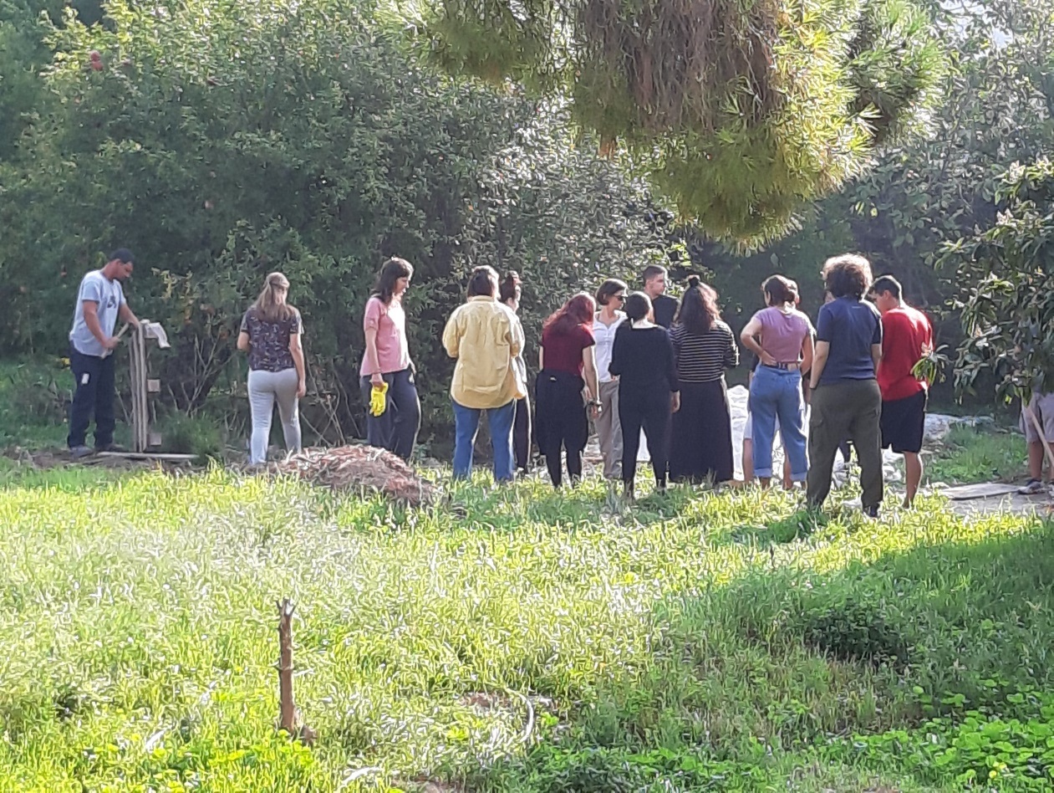
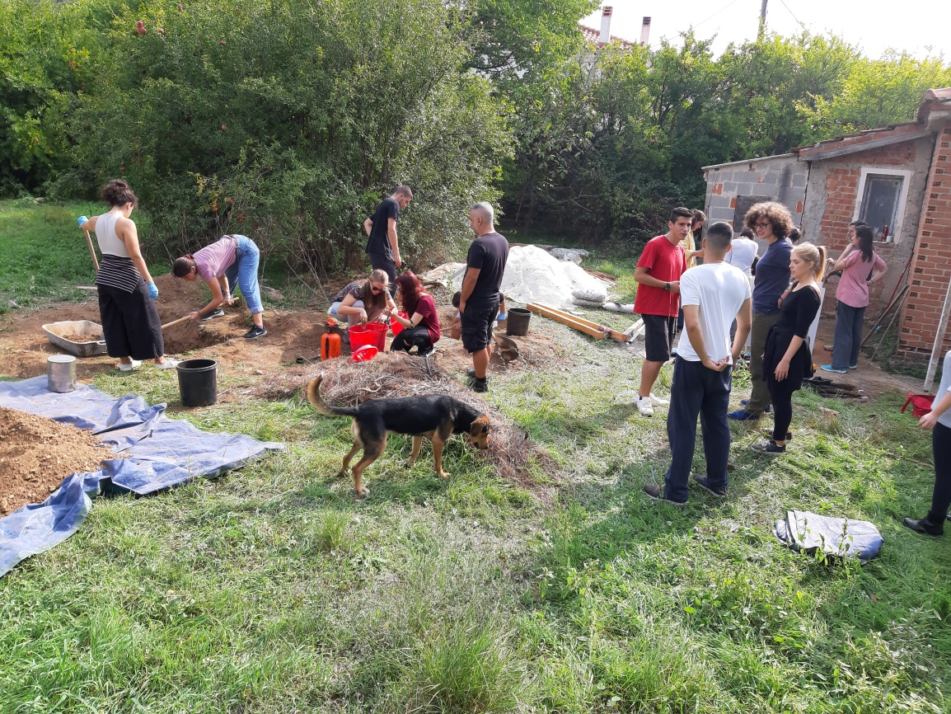

Slide 6
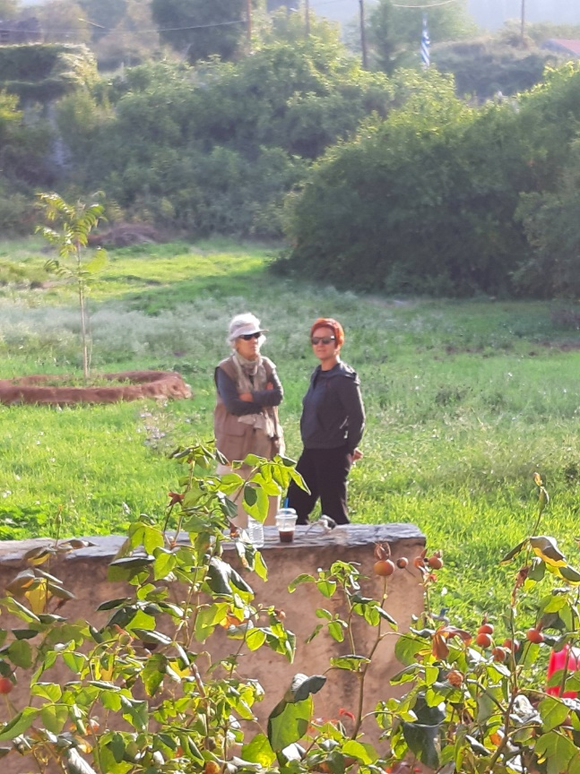
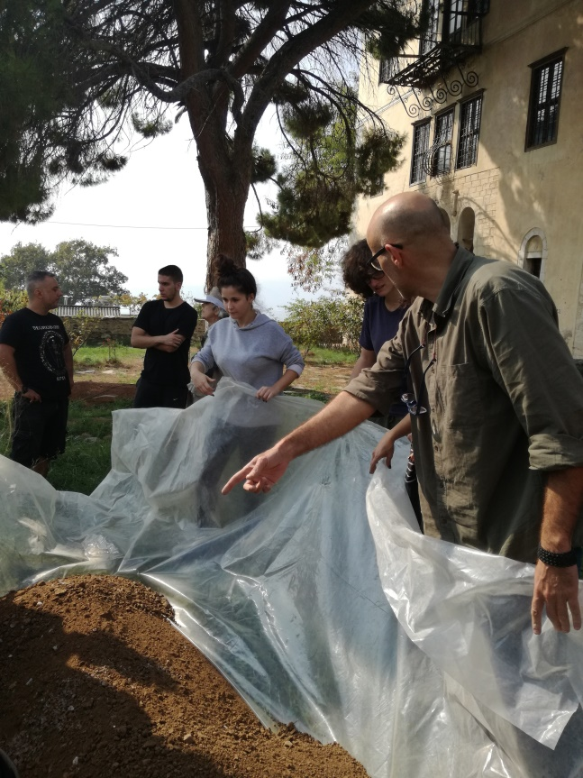
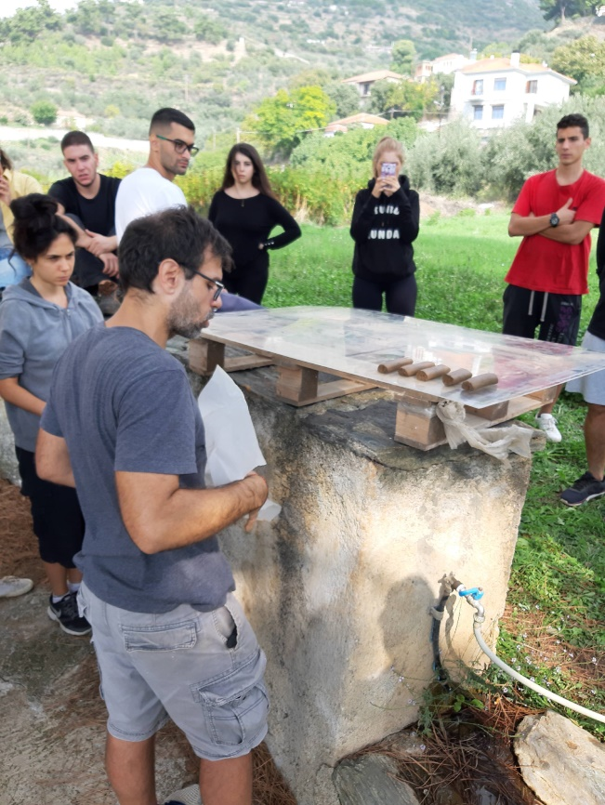
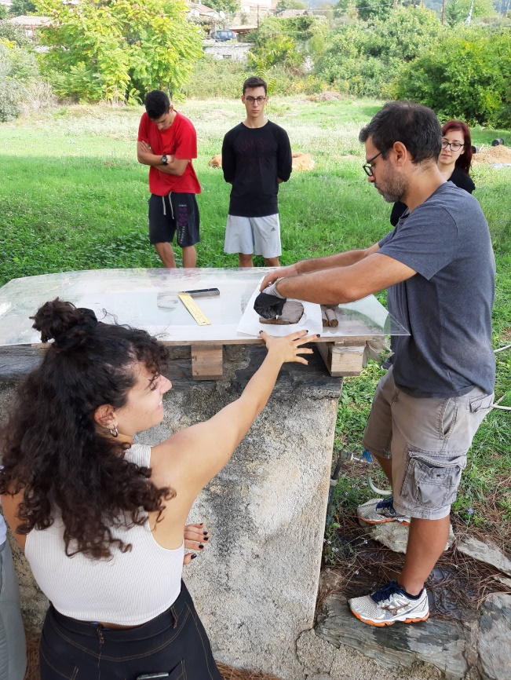
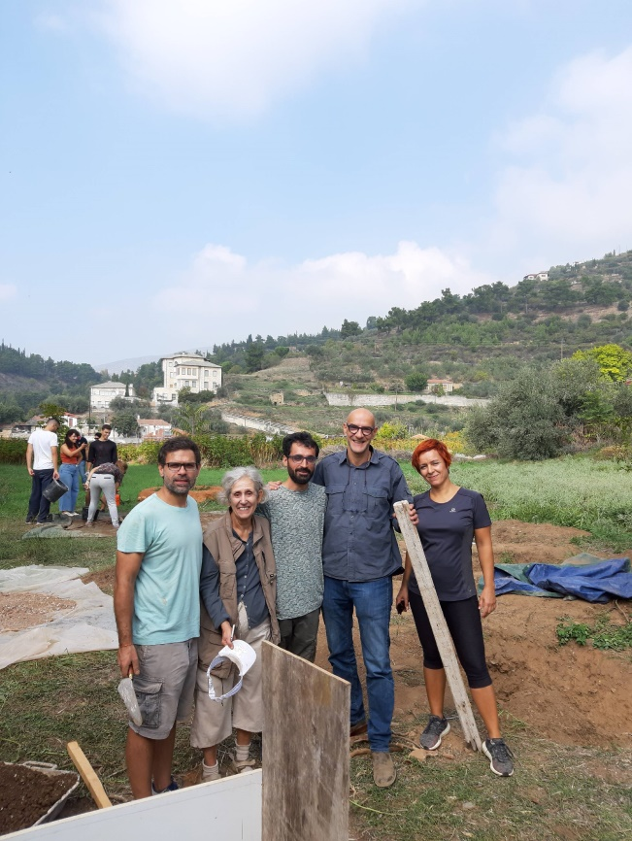
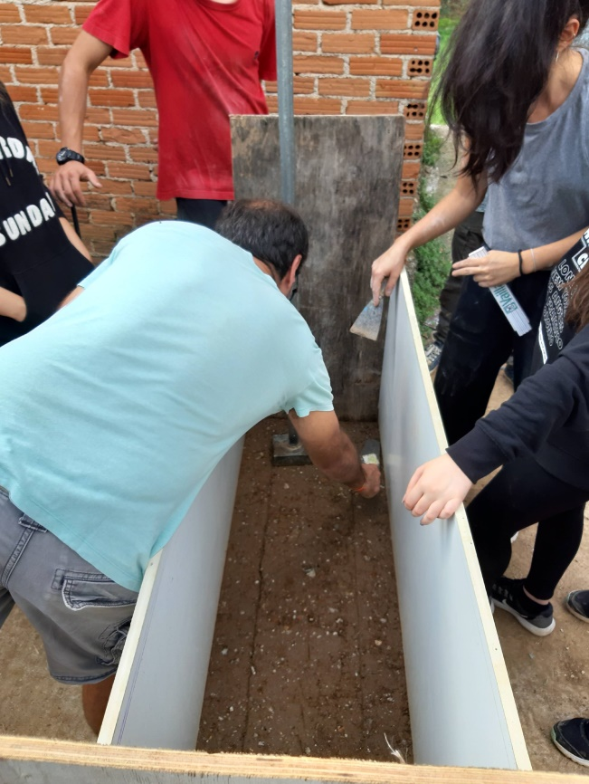
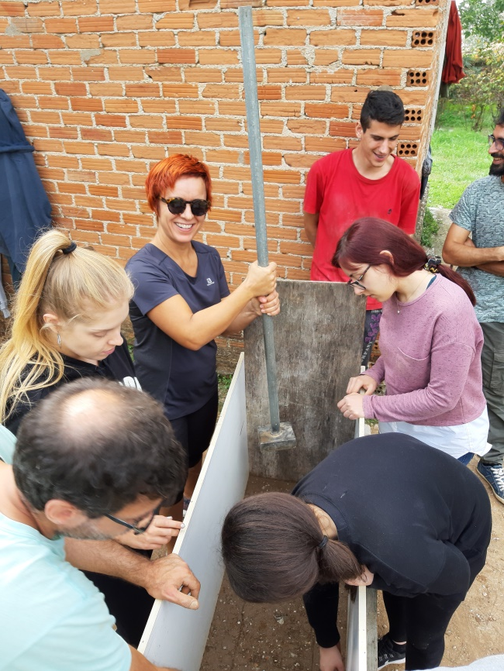
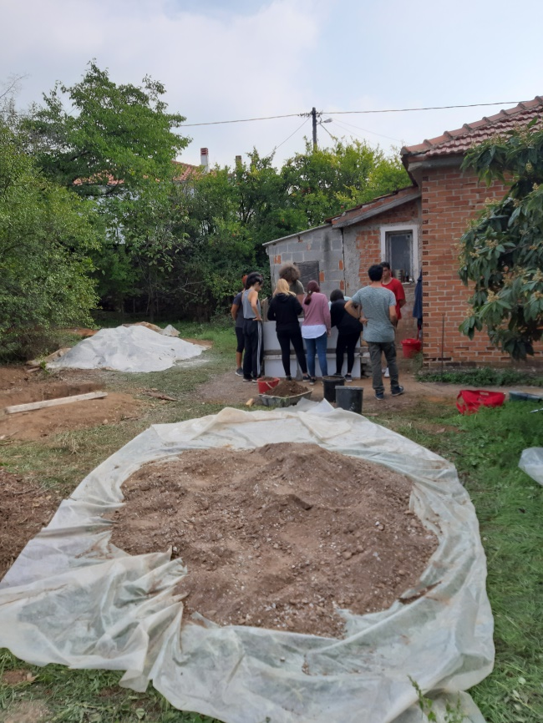

Slide 7
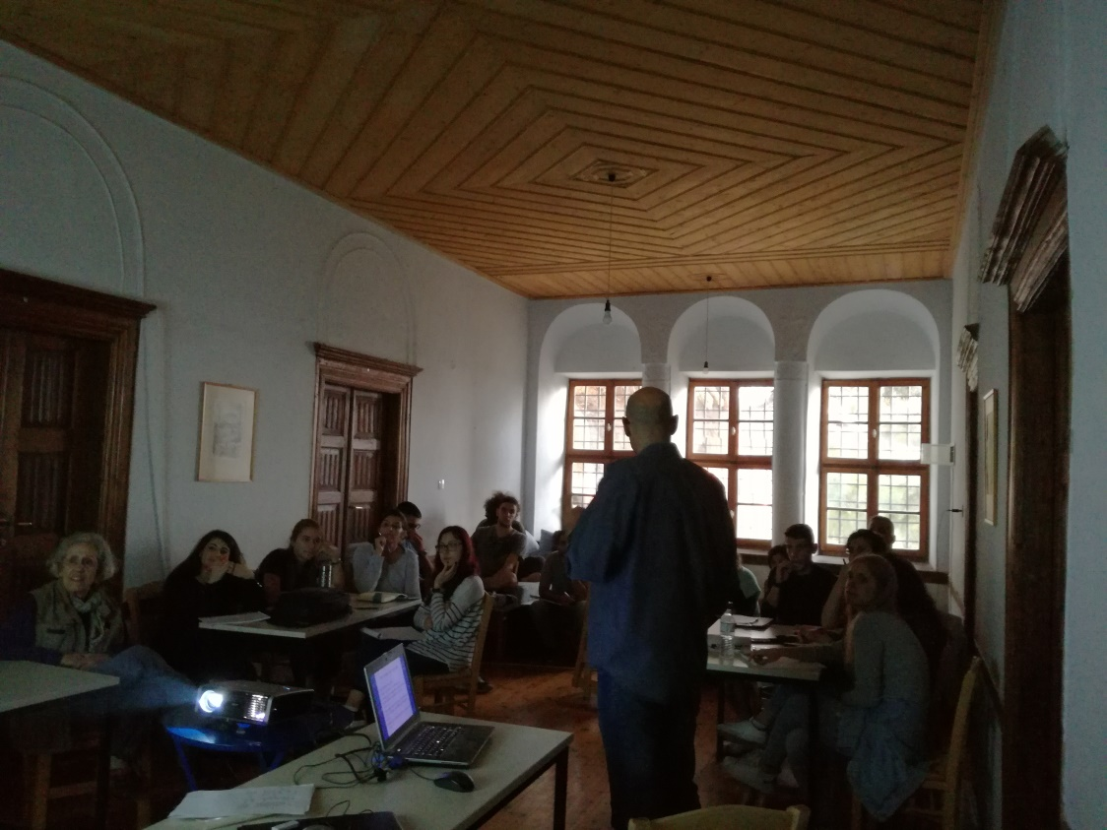
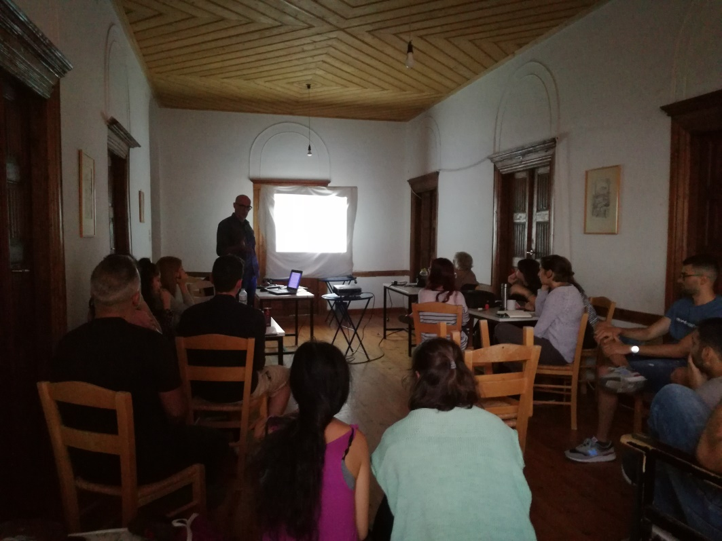
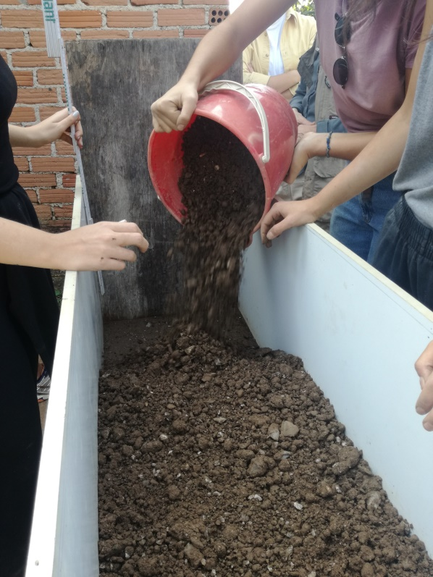
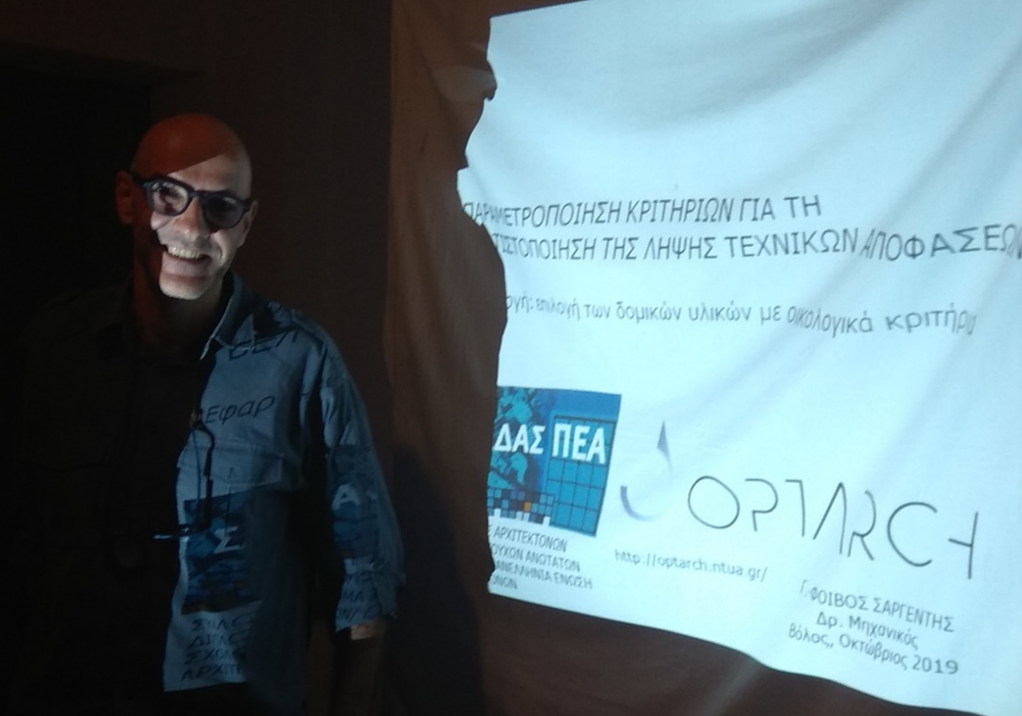
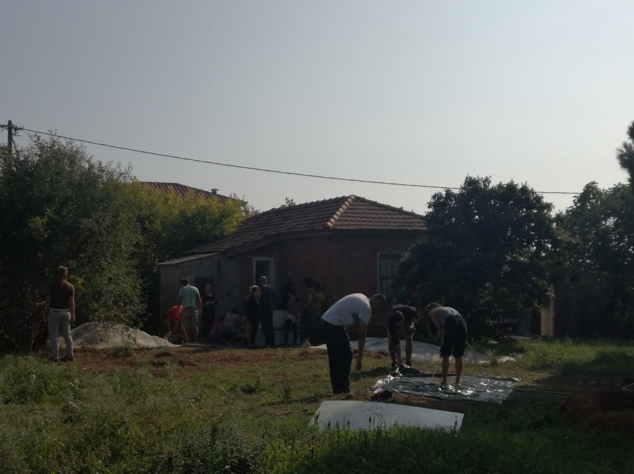
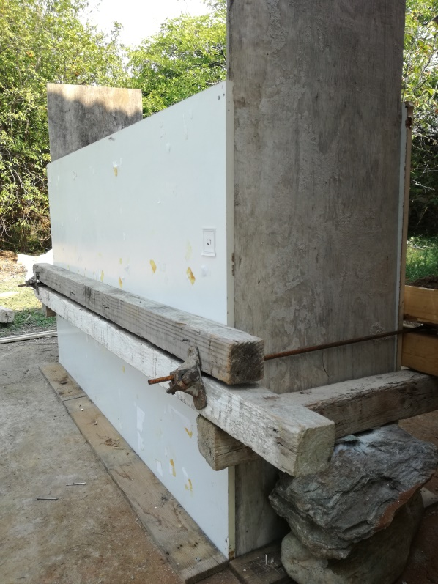

Slide 8
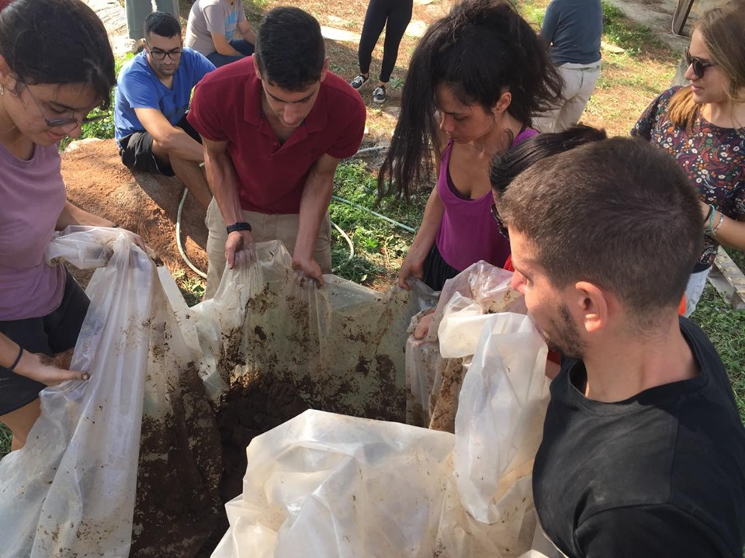
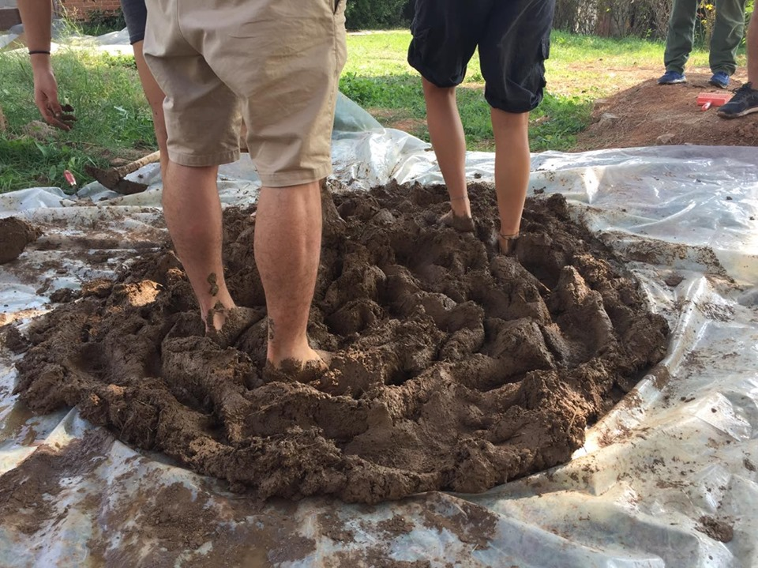
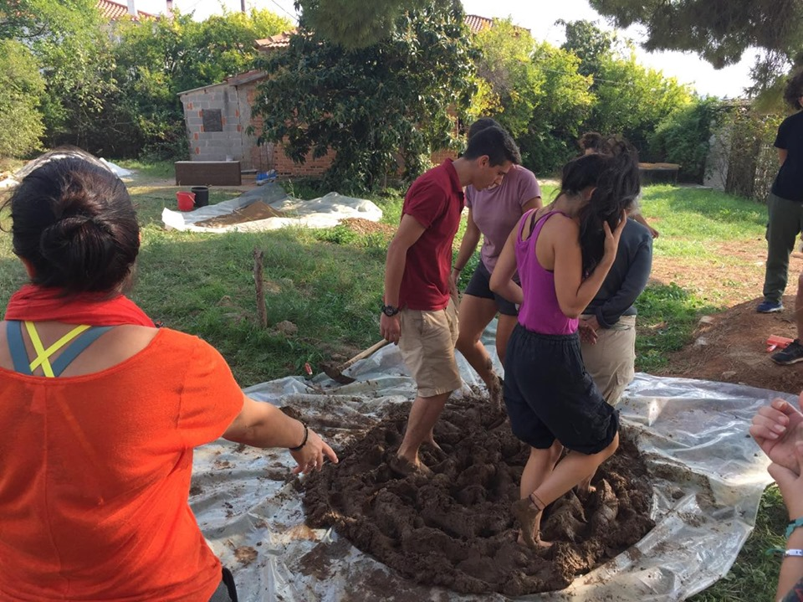
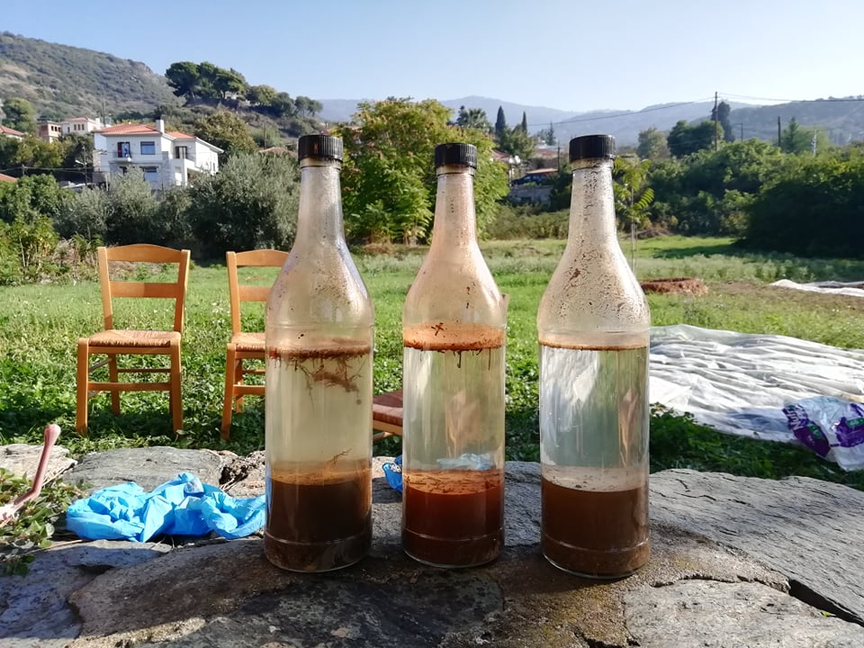
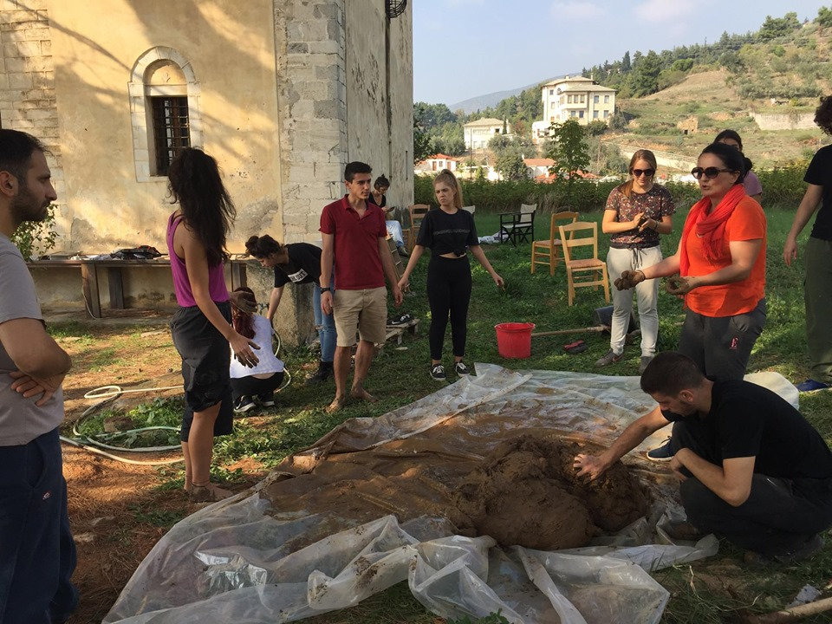
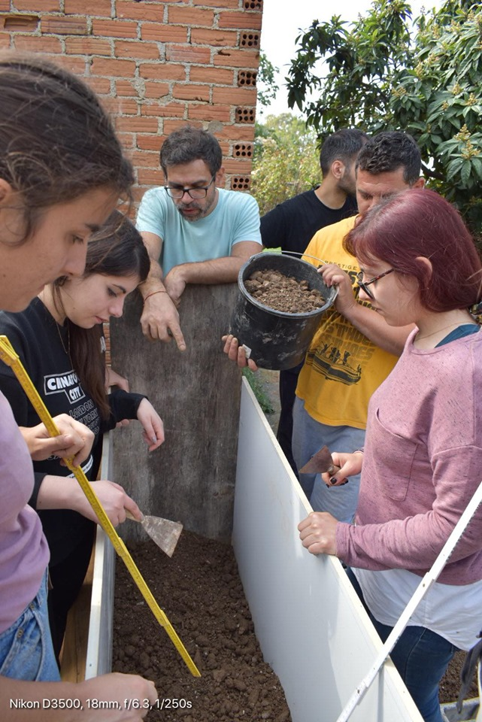
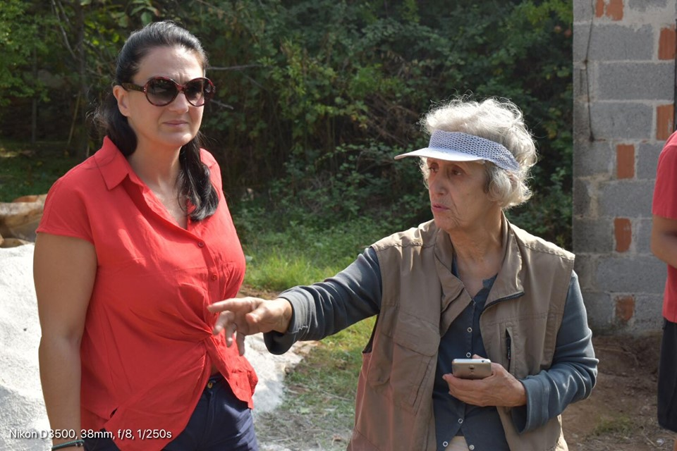
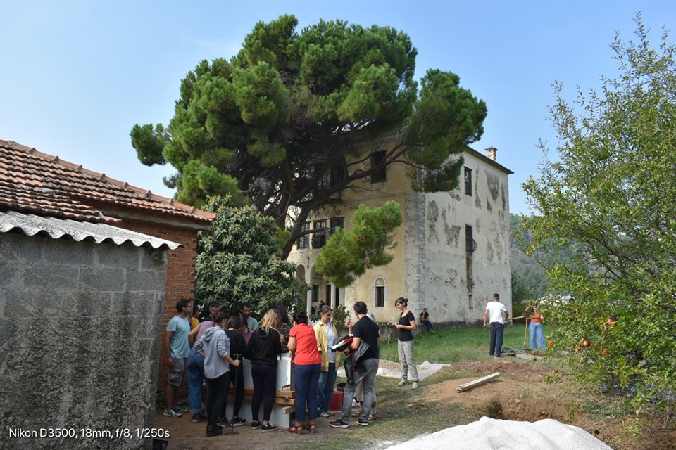

Slide 9
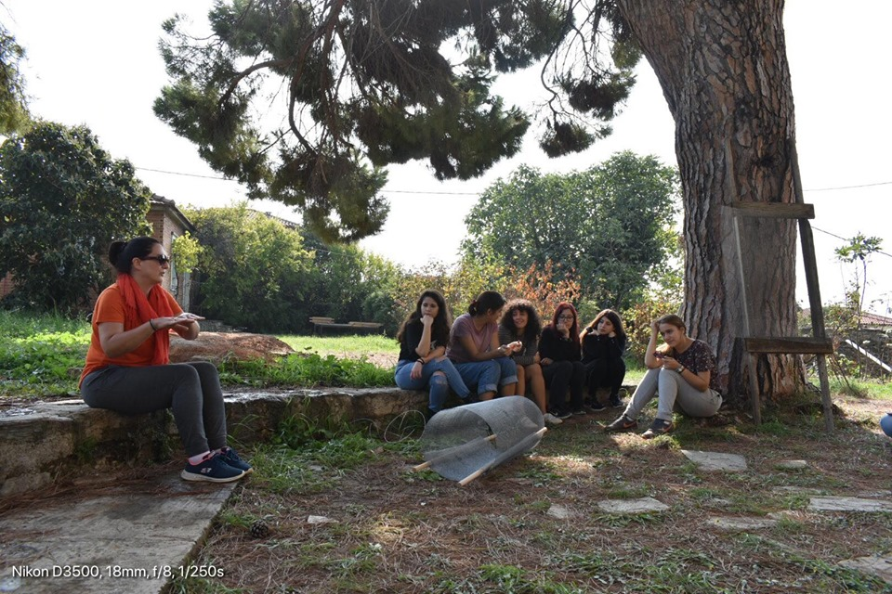
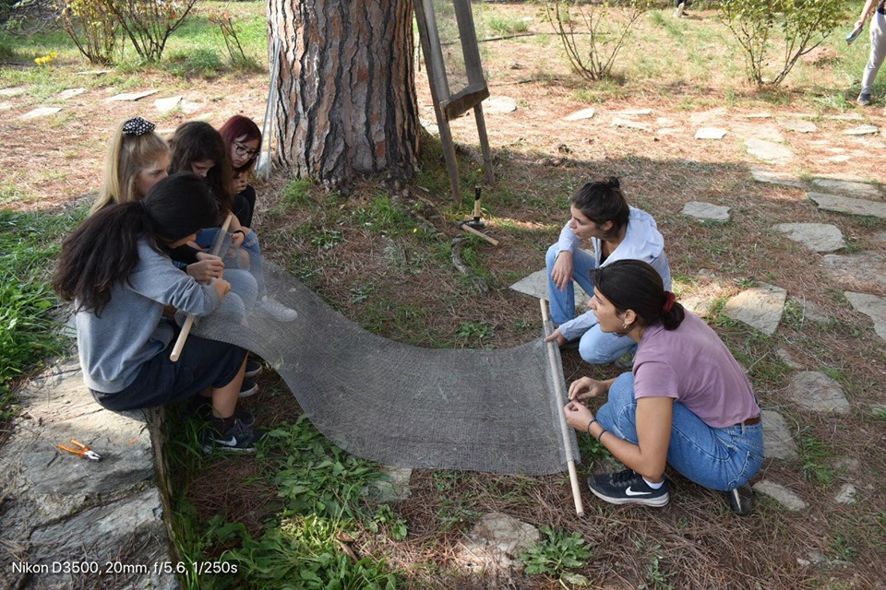
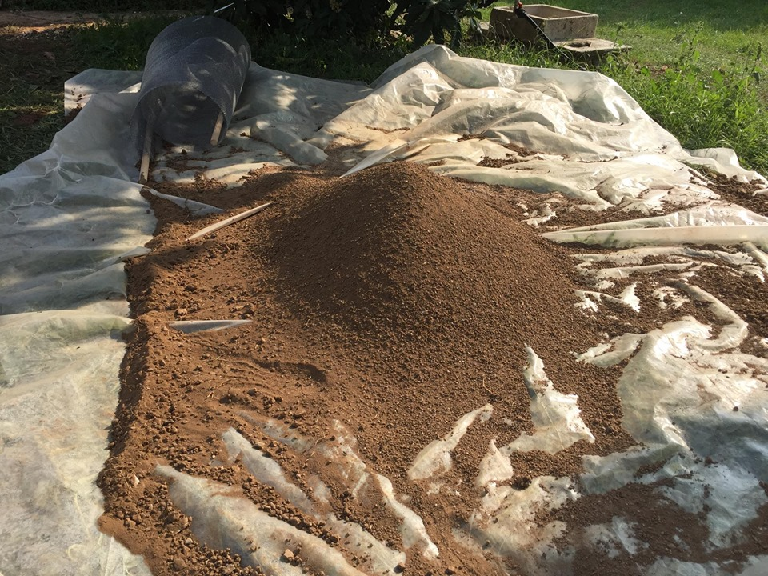
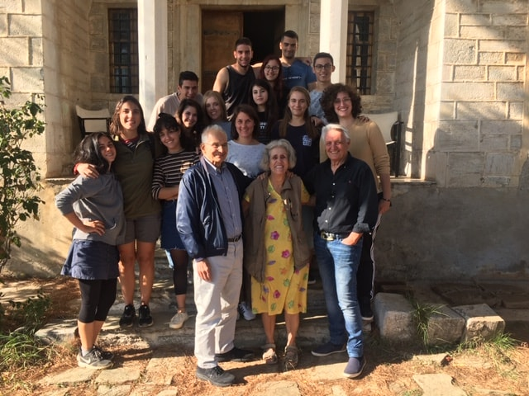

Slide 10
